Slide 1
Contrastive Language-Audio Pretraining (CLAP): LEARNING AUDIO CONCEPTS FROM NATURAL LANGUAGE SUPERVISION
Review Presentation compiled by Khadijah Ahmed and Debayan Mukhopadhyay, Department of Computer Science and Engineering, University of Calcutta

Slide 2
Index
Topic | SL No. | Sub Topic | Slide No.
Motivation | 1.1 | Limitations of Audio Analytics Models before CLAP | 3
 | 1.2 | Exploring Natural Language Supervision for Audio Learning | 4
 | 1.3 | Brief Introduction to Contrastive Learning | 5
 | 1.4 | Brief Introduction to Self-Supervised Learning | 6
 | 1.5 | Comparative Study: Contrastive Learning vs. Attention Mechanism | 7
Methodology and Practical Implementation | 2.1 | Three Major Steps | 9
 | 2.2 | Training Dataset Characteristics | 10
 | 2.3 | Theoretical Workflow | 11
 | 2.4 | Audio Data Preprocessing with Librosa | 12
 | 2.5 | Textual Data Preprocessing and Encoding with BERT | 16
 | 2.6 | Generating the Contrastive Joint Multi-Modal Space | 17
 | 2.7 | Contrastive Loss and Training Configurations | 18
Results and Discussions | 3.1 | Zero Shot Classification | 19
 | 3.2 | Downstream Tasks that CLAP was tested on | 20
 | 3.3 | Zero Shot Performance | 21
 | 3.4 | Supervised Setup Performance | 22
 | 3.5 | Challenges Encountered while Training with AudioSet | 23
References | 4 | References | 24

Slide 3
Motivation: Limitations of Audio Analytics Models Before CLAP
Traditional Audio Analytics Models:
Trained with a supervised learning approach, associating audio recordings to predefined class labels for specific tasks (e.g., Sound Event Classification, Acoustic Scene Classification)
Limitations:
Can only predict specific categories they were trained on
Lack flexibility to predict unseen classes
Require labeled audio data, which is resource-intensive and time-consuming to obtain
Need for Flexibility and Generalization:
Human Auditory System: Capable of interpreting a wide range of sounds and meanings in various contexts without predefined categories
Goal: Develop models that can predict any audio class on-the-fly without requiring additional training, thus enabling Zero-Shot learning

Slide 4
Exploring Natural Language Supervision for Audio Learning
Current Self-Supervised Learning (SSL) Approaches:
Pretrain models with unlabelled audio data, which avoids the constraints of labelled datasets.
Exclude semantic knowledge from natural language, which limits understanding the contextual meaning of sounds.
Advantage of Natural Language Supervision:
Computer Vision Success: Models like CLIP and Florence learn image representations with natural language supervision, achieving high Zero-Shot performance across multiple tasks.
Underexplored in Audio: Applying natural language supervision to audio could enable flexible class prediction and generalization to multiple downstream tasks.
Proposed Solution: Contrastive Language-Audio Pretraining (CLAP):
Learn audio concepts using natural language descriptions to create a joint multimodal space.
Enables Zero-Shot predictions, thus removing the need for predefined categories and allowing more generalized and flexible audio analysis.

Slide 5
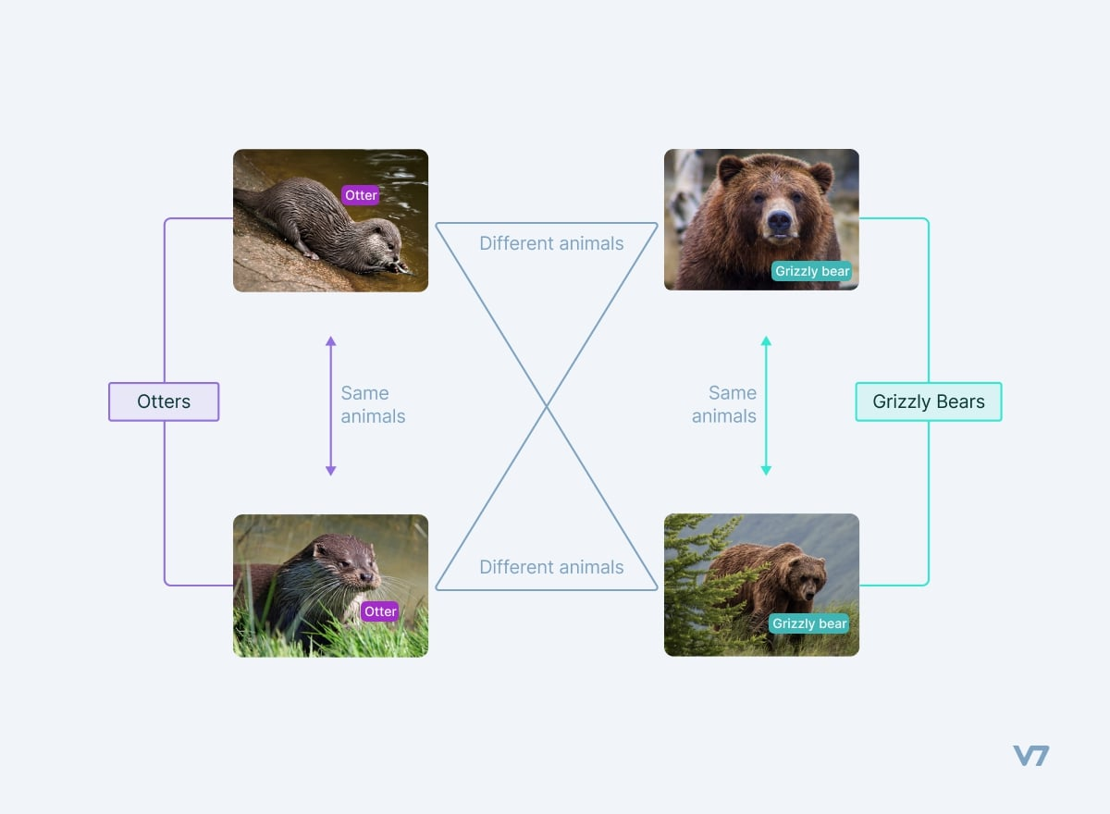
Brief Introduction to Contrastive Learning
What is Contrastive Learning?
A self-supervised learning technique where models learn to differentiate between similar and dissimilar data points.
Goal: Bring semantically similar data points closer in the feature space and push dissimilar points apart.
Key Components:
Encoders: Neural networks that convert input data (e.g., audio, text) into a high-dimensional vector representation.
Contrastive Loss: A function that minimizes the distance between positive pairs (similar samples) and maximizes the distance between negative pairs (dissimilar samples).
Applications in Multimodal Learning:
Used to align different modalities, such as text and images in CLIP or text and audio in CLAP, into a shared feature space.
Enables models to generalize across tasks and perform Zero-Shot learning by finding the most semantically relevant matches in the feature space.
Minimize the distance between the embeddings of these two data points in the vector space
Maximize the distance between the embeddings of these two data points in the vector space

Slide 6
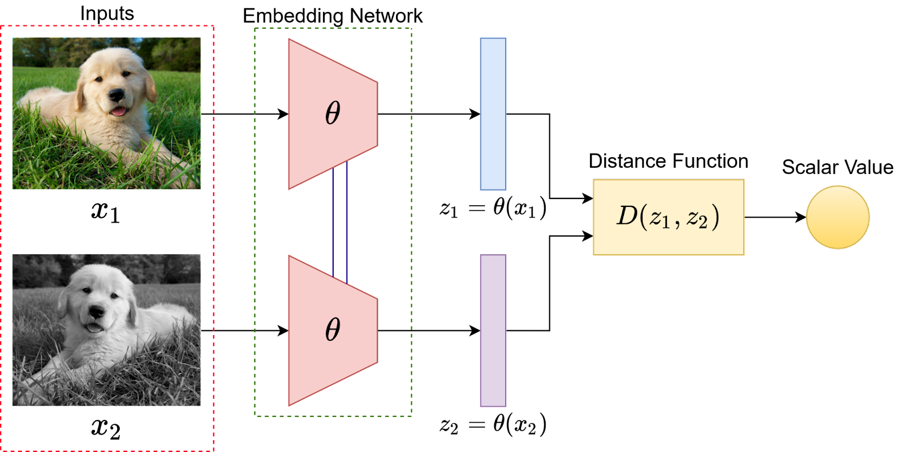
Brief Introduction to Self-Supervised Learning
What is Self-Supervised Learning? A learning paradigm that leverages the data itself to generate supervisory signals, avoiding the need for manually labelled datasets. Types of Pretext Tasks: Predicting missing parts of the input (e.g., masked language modelling in NLP) Temporal order prediction in video/audio data.
Advantages: Limitations of Supervised and Reinforcement Learning: Supervised Learning relies on human-annotated labels to train models, allowing computers to mimic human decision-making based on labeled examples. However, labeling large datasets is often impractical. Reinforcement Learning offers an alternative by rewarding or penalizing model predictions, but it also becomes infeasible in many practical scenarios due to the need for ongoing interaction and feedback. Self-Supervised Learning (SSL) as an Alternative: SSL provides a different approach by enabling machines to independently generate and validate labels, similar to human cognitive processes. In SSL, the model autonomously determines the reliability of the labels it generates and uses this feedback to adjust its weights in subsequent iterations, reducing the need for human involvement in the AI training process. It utilizes vast amounts of unlabelled data, which is more abundant than labelled data, while also learning rich, generalizable feature representations that can be fine-tuned for various downstream tasks with minimal labelled data | Disadvantages: High Computational Requirements: Self-Supervised Learning (SSL) requires significant computational power as the model must both interpret unlabeled data and generate corresponding labels. This process is more demanding than supervised learning, where labeled examples with ground truths are provided. For instance, in contrastive learning (a type of SSL), training involves sampling multiple anchor-positive and anchor-negative pairs for each iteration, which slows down the training process. Potential for Lower Accuracy: SSL models may have lower accuracy compared to supervised learning models because they generate their own labels without external validation. If the model makes a high-confidence incorrect prediction, it may reinforce the error without adjusting the weights properly, leading to persistent inaccuracies in the model's learning.
When the two inputs are similar to each other (two augmented versions of a dog image), the distance calculated should be small

Slide 7
Comparative Study: Contrastive Learning vs. Attention Mechanism
Contrastive Learning: Objective: Learn representations by comparing positive (similar) and negative (dissimilar) pairs. Mechanism: Utilizes contrastive loss to bring similar data points closer in embedding space and push apart dissimilar ones. Strengths: Effective in learning discriminative features that generalize across tasks. Particularly useful for Zero-Shot learning and multimodal alignment (e.g., audio-text) | Attention Mechanism: Objective: Focus on the most relevant parts of the input data to improve prediction performance. Mechanism: Computes a weighted sum of input features, where weights (attention scores) indicate the importance of each feature. Commonly used in Transformers and sequence modeling tasks. Strengths: Excels in handling variable-length input sequences, modeling long-range dependencies, and improving interpretability by highlighting which input features are most important.
Similarities: Both aim to improve learning efficiency and model performance by emphasizing relevant data relationships Both approaches make use of an encoding or embedding mechanism that maps data points to a vector in a n-dimensional vector space. Followed by this the Attention Mechanism “pulls” or “gravitates” data points towards relevant clusters based on context, while contrastive learning, generates the vector space such that similar data points have lesser distance compared to dissimilar data points Can be integrated into complex models to enhance representation learning (e.g., combining contrastive learning with attention in multimodal tasks) | Differences: Contrastive Learning is more about distinguishing between different data points, while Attention focuses on selectively processing parts of a single input. Contrastive Learning is often used for representation alignment in different modalities, whereas Attention is used to capture dependencies within a single modality or between modalities in a sequence.

Slide 8
Overview of the Adopted Methodology

Slide 9
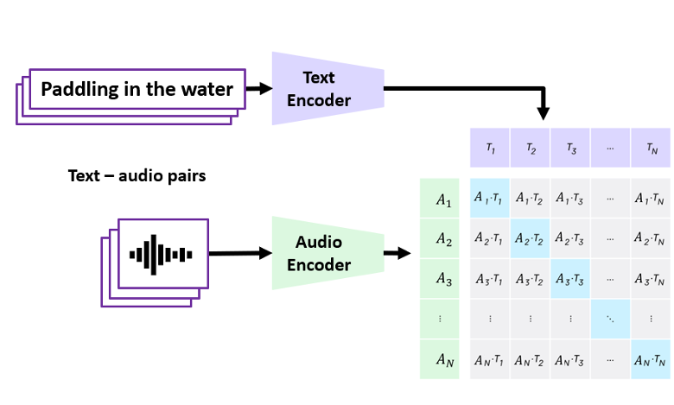
Three Major Steps
The input is audio and text pairs passed to an audio encoder and a text encoder
The CNN14 model was used as the audio encoder trained on 2M audio clips from the AudioSet dataset
The text encoder chosen is the HuggingFace implementation of BERT base uncased model
Both representations are connected in joint multimodal space with linear projections
The space is learned with the (dis)similarity of audio and text pairs in a batch using contrastive learning
Both, the audio and text embeddings are projected into a multimodal space with two learnable transformation matrices resulting in an output dimension of 1024
BERT maps the preprocessed input text (max size 100 characters) to a 768 dimensional vector
CNN14 maps the preprocessed audio data to a 2048 dimensional vector

Slide 10
Training Dataset Characteristics
The authors employe128,010 audio and text pairs from 4 datasets to construct the training dataset for CLAP
Dataset Name | Number of Samples Taken
FSD50k | 36,796
ClothoV2 | 29,646
AudioCaps | 44,292
MACS | 17,276
Total | 128,010

Slide 11
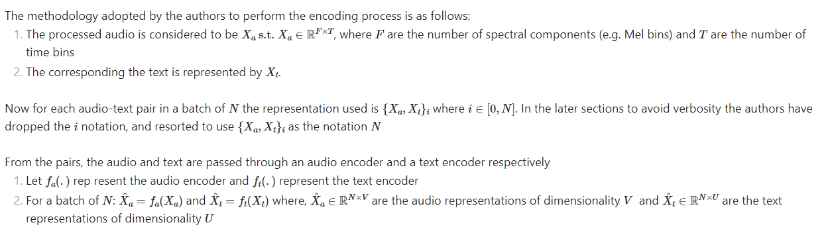
Theoretical Workflow

Slide 12
Audio Data Preprocessing
Preprocessed Audio Data Parameters | Advantages of using Mel Spectrogram Representation over other wave-form formats
The audio data is represented as log Mel spectrogram with: Sampling rate of 44.1KHz Hop-size of 320s Window size of 1024s 64 Mel bins in the range of 50-8000Hz Each audio clip is randomly truncated to a continuous segment of 5s,or padded if shorter | Frequency Resolution Adaptation: The Mel scale approximates the human ear's perception of sound, allocating more bins to lower frequencies where humans are more sensitive and fewer bins to higher frequencies This helps the CNN14 model focus on the most relevant features for downstream tasks involving human perception, like speech and music Dimensionality Reduction: By converting audio into Mel-frequency bins, the input data is reduced in size compared to raw audio waveforms or linear spectrograms This reduction simplifies the input while retaining essential frequency information, making the training process more efficient and less computationally intensive Reduced Sensitivity to Noise: The log Mel spectrogram is less sensitive to noise than raw audio signals or linear frequency spectrograms This makes the CNN14 model more robust in real-world applications where audio signals might be degraded by background noise

Slide 13
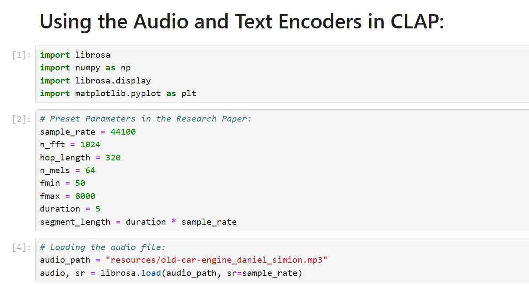
Audio Data Preprocessing using Librosa

Slide 14
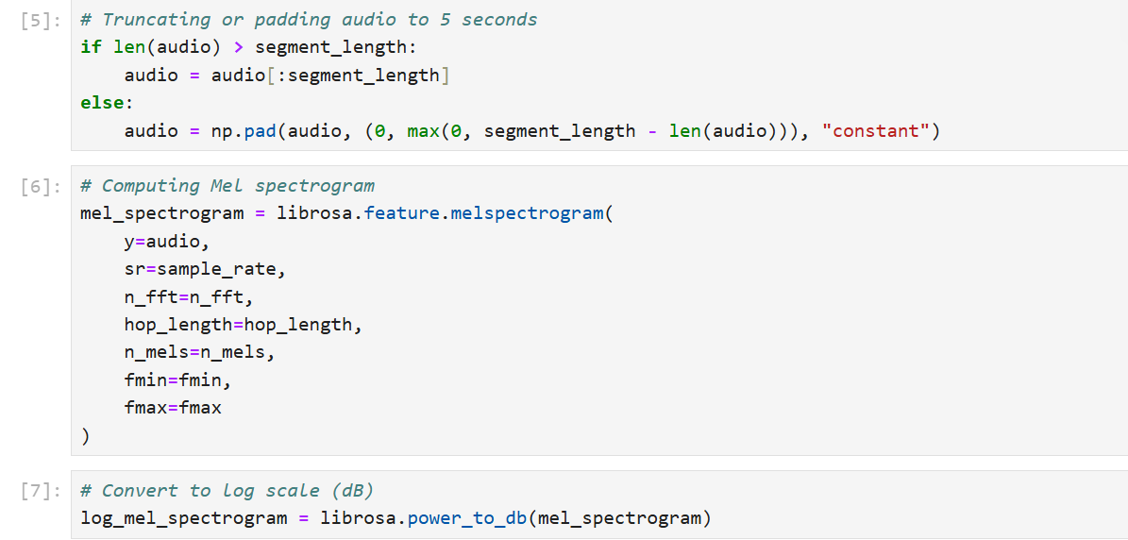
Audio Data Preprocessing using Librosa

Slide 15
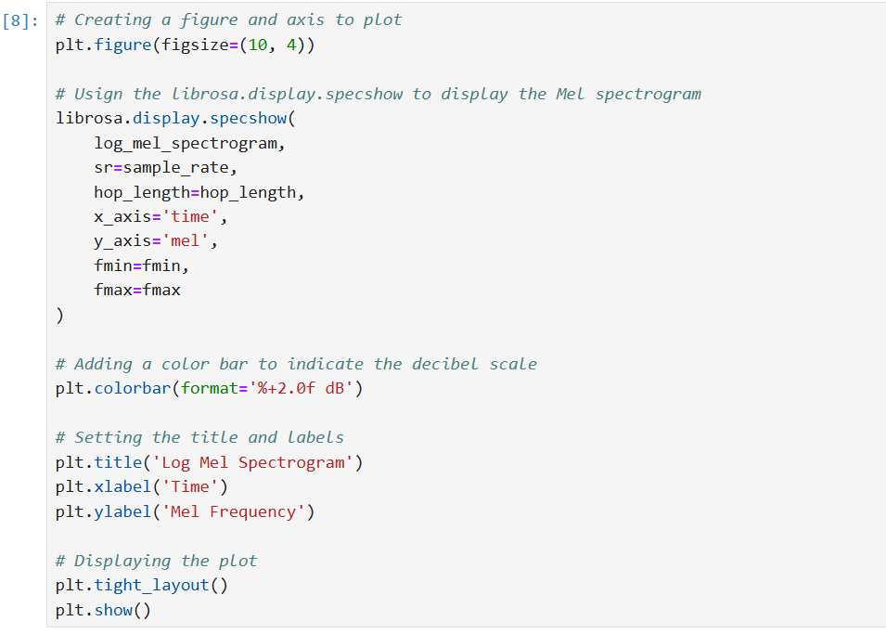
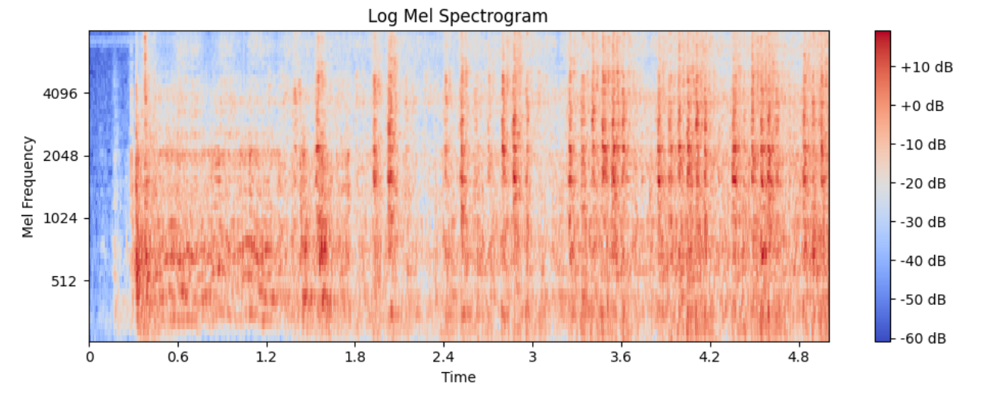
Audio Data Preprocessing using Librosa
Figure: Plot of the log Mel Spectrogram for the corresponding input audio
Followed by this, the above preprocessed version of the audio clip needs to be passed into the input layer of the CNN14 encoder model to generate the embedding

Slide 16
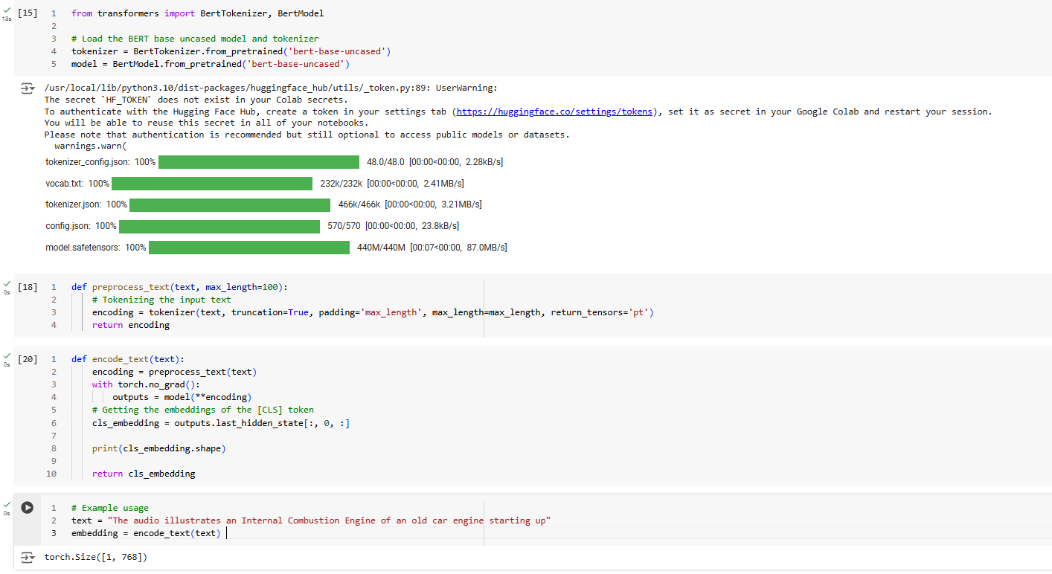
Text Data Preprocessing and Encoding using BERT
The textual data representing the corresponding caption is restricted to a maximum size of 100 characters in order to make the computation efficient
The BERT encoder model then maps the preprocessed input text to a 768 dimensional vector

Slide 17
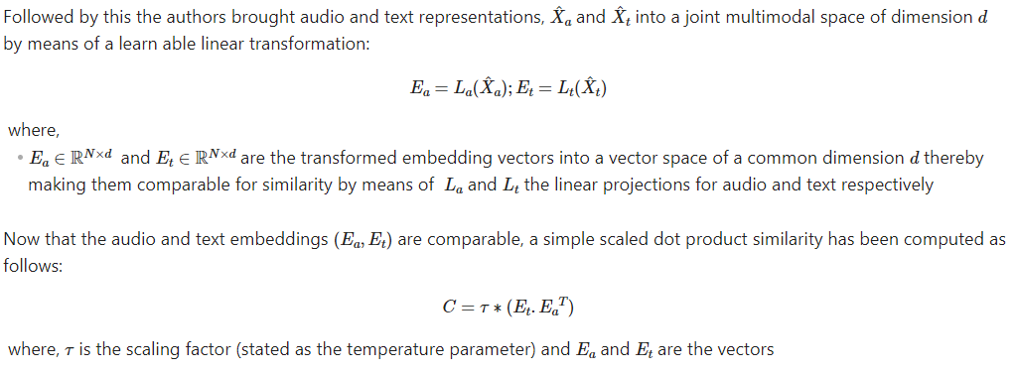
Generating the Contrastive Joint Multi-Modal Space
The temperature parameter has been initialized to 0.007 by the authors

Slide 18
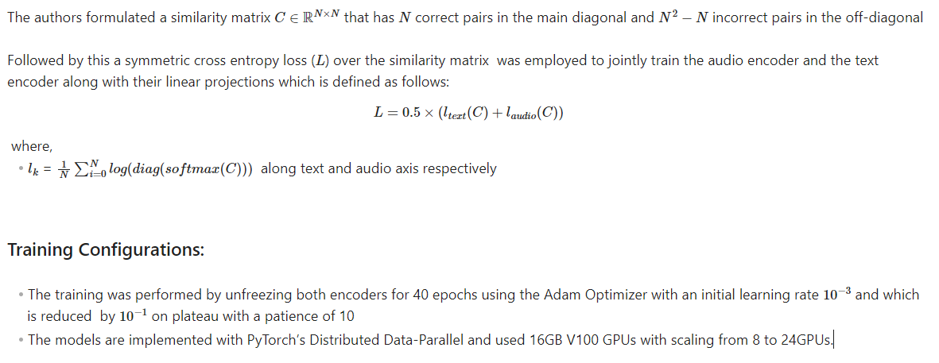
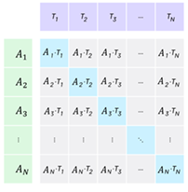
Contrastive Loss and Training Configurations
The cells highlighted in blue along the main diagonal represent the correct pairs In the similarity matrix

Slide 19
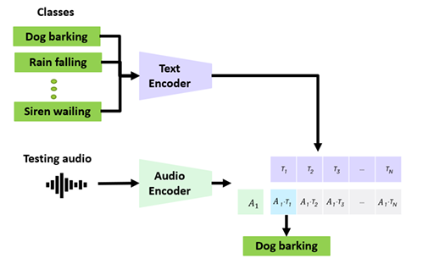
Zero Shot Classification
The authors have used CLAP’s ability to determine the similarity between audio and text in order to use it for zero shot classification. The steps are as follows: Embedding Computation: For each test audio and class label, embeddings are generated using pre-trained encoders and their projection layers Similarity Calculation: The cosine similarity between audio embeddings and class label embeddings is computed Probability Distribution: The computed similarities are transformed into a probability distribution using appropriate activation functions (SoftMax for multiclass and sigmoid for multilabel classification)
Advantages of the Zero Shot Ability: The approach is advantageous in scenarios where labeled data for the target classes is unavailable. By leveraging pre-trained embeddings, it avoids the need for retraining and provides flexibility in classification tasks Utilizing embeddings from both audio and text in a shared space ensures that the model captures cross-modal similarities effectively. This can enhance the accuracy of classification, especially in contexts where the relationship between text and audio is crucial | Potential Limitations: The approach may struggle with generalizing to highly domain-specific or niche classes that are not well-represented in the pre-training data. The embeddings might not capture subtle nuances relevant to these classes While cosine similarity is effective, it assumes that the embeddings are centered and normalized. If the embeddings do not align well or exhibit significant variance, the similarity measure might not capture the true relationship between audio and text.

Slide 20
Downstream Tasks that CLAP was tested on
The authors decided upon the following downstream tasks to evaluate the robustness of CLAP which cover a diverse range of audio analytics across 16 datasets from 8 different domains:
Sound Event Classification: Five tasks focus on identifying different sound events, such as environmental sounds and specific actions or objects.
Music-Related Tasks: Five tasks are related to music, including the classification of music versus speech, identifying music genres, and recognizing musical elements like strokes and tonics.
Acoustic Scene Classification: One task involves classifying different acoustic scenes, such as indoor versus outdoor environments.
Speech-Based Tasks: Four tasks focus on speech, including Emotion Recognition (identifying emotions in speech), Keyword Spotting (detecting specific words), and Vocal Sound Classification (classifying sounds like coughing, sneezing, or laughter).
Speaker Counting: One task involves counting the number of speakers in an audio recording, ranging from 0 to 10 speakers.

Slide 21
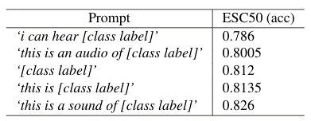
Results and Discussions: Zero Shot Performance
Sound Event Classification (SEC) Datasets: ESC50: Achieved 82.6% accuracy, surpassing human performance (81%) and AudioCLIP (69%) by 12% US8K: Achieved 73% accuracy, outperforming AudioCLIP (65%) by 8% FSD50K: Achieved a mean Average Precision (mAP) 27% higher than Wav2CLIP. Music vs Speech Classification (GTZAN): Achieved 100% accuracy, outperforming supervised models Instrument Classification: Achieved 47% accuracy, 22% higher than random. Vocal Sound Dataset: Achieved 50% accuracy, 33% improvement over random. Emotion Recognition (ER) and Keyword Spotting (KWS): Outperformed random by up to 4% accuracy. Conclusions: Demonstrates the potential of reliable audio models with no additional training required Performed better than random on all downstream tasks Achieved good to slightly better than random results on music and speech-related tasks | CLAP is trained on natural language captions that consist of one or more sentences, while many datasets use class labels defined by single words, such as “dog barking” or “sneezing.” This discrepancy affects how well Zero-Shot learning transfers. To address this issue, standard template prompts like “This is a sound of [class label]” were used. These prompts help align the model's understanding with the class label format used in the datasets. Experimentation showed that using these prompts improved CLAP’s Zero-Shot performance. For instance, changing prompts for the ESC50 dataset resulted in a 5% increase in accuracy.

Slide 22
Results and Discussions: Supervised Setups
Best Performance (Supervised Setups):
GTZAN Music vs Speech Classification: Achieved 100% accuracy
GTZAN Music Genre Classification: Achieved 91.3% accuracy
MRI Stroke Classification: Achieved 97.94% accuracy
MRI Tonic Classification: Achieved 95.34% accuracy
Vocal Sounds Classification: Achieved 97.95% accuracy
Performance Relative to SoTA:
Underperformed by at most 7% on other tasks compared to SoTA
Lowest Performance: ER’s RAVDESS with 64% accuracy vs SoTA of 81%
Domain-Specific Performance:
Better Performance in Sound Event Classification (SEC) compared to Emotion Recognition (ER)
The discrepancy is attributed to CLAP’s training data, which is rich in audio captioning for sound events but lacks human speech-based captions
Conclusions:
CLAP performs better in SEC due to its training on sound event descriptions.
Performance on speech tasks is lower due to scarce training data and lack of descriptive captions for human speech. Increasing training data and including more human speech-based captions could enhance CLAP’s performance on speech-related datasets

Slide 23
Challenges Encountered while Training with AudioSet
AudioSet is a multi-labeled sound event dataset with 2 million audio clips, but it does not provide text descriptions for each clip, making it difficult to extract audio-text pairs for training
To construct text descriptions, CLAP experimented with using the title and class labels from AudioSet. However, adding approximately 1.7 million new audio-text pairs to the existing 128,000 pairs resulted in a decrease in overall Zero-Shot performance
For example, the ESC50 dataset's accuracy dropped from 82.6% to 67.15%, and the US8K dataset's accuracy decreased from 73.24% to 70.93%.
Only the Speech Commands V2 (SCV2) dataset showed improvement, with accuracy increasing from 10% to 15%, possibly due to the large amount of speech content in AudioSet
These results suggest that the quality of audio-text pairs is crucial for training CLAP effectively. In AudioSet, YouTube titles and descriptions often do not accurately describe the acoustic content of the specific video segments but rather the video as a whole.
This mismatch highlights the need for more intelligent methods of generating text descriptions that better align with the actual audio content. Improving these methods could significantly enhance CLAP’s training effectiveness with AudioSet and other similar datasets
Generally, finding high-quality training data for CLAP from public datasets is challenging. This difficulty necessitates relying on large-scale, noisy pairs as the only scalable approach, despite the potential drawbacks in performance.

Slide 24
References
[2206.04769] CLAP: Learning Audio Concepts From Natural Language Supervision (arxiv.org)

